Slide 1
RPS - Formulary Complete
Sprint 5 Planning

Slide 2
Agenda
Sprint 4 Deliverables’ Status
Sprint 4 Retrospective
Sprint 4 metrics
Project Status
Sprint 5 Plan
Sprint 5 Implementation Plan A
Sprint 5 Implementation Plan B (Contingency)
Change Requests
Risks & Impact
Questions?

Slide 3
Sprint 4 – Deliverables’ Status
User Story | Summary | Status | Remark
FC 212, 213 and 214 | • Refactoring for Pharma Press - Drug Services, Search Services, Admin Services | Completed
FC 215, 216 and 217 | • Refactoring - Search Module, Local Records Listing, Local Records Creation | Completed
FC 218 | • Monograph - Template Implementation | Incomplete | Header and footer template segregation is complete. James is rendering BNF content in templates
FC 220 | • Logger Implementation | Complete
FC 221 | • Exception Handling Server Side Client Side | Incomplete | Pending Testing

Slide 4
Sprint 4 – Deliverables’ Status
User Story | Summary | Status | Remark
FC 223 | • Object Mapper Changes | Complete
FC 200 | • Search Functionality | Complete
FC 242 | • View BNF changes | Complete
FC243 | • Creating Access Management Services | Complete
FC 147 | • Local record content creation: adding and editing fixed text | Incomplete | Roll over for File upload. Testing in progress
FC 238 | • Managing Work Queue | Incomplete | Development Partially complete.
FC 244 | • Removing all session states | Complete
FC 147 | • Local record content creation: adding editing | Incomplete | Testing in progress

Slide 5
Sprint 4 – Goals and status
Goal for the Stabilization Sprint | Status | Remarks
All common dependencies factored out, and everyone on the same code base | Completed
All projects building automatically on check in to Github | Completed
Daily automatic deployment of projects to Azure | Incomplete | With James
Up to date ElasticSearch on Azure | Completed
Web-app re-factored to controller, Service, with dependency injection | Completed
Unit Tests for controllers and services | Completed
Drug monograph template re-factored with separate templates for each pot | In Progress | With James.
Using Json Format (removing Object Mapper | Completed

Slide 6
Sprint 4 – Retrospective
What Worked
Frequent check-ins, and prompt code reviews.
Refactoring Activities.
Offshore team size increased.
The new functionality was coded for post high level design approval from Ian.
What can be improved
Deliverables.
Peer review before checking-in code.
Ensuring the issues identified in earlier review are not repeated.
Discussion of design before working on a new module.
Web UI design to be finalized as early as possible in the sprint.
Logging time in JIRA
Questions on functionalities to be asked earlier in the sprint.

Slide 7
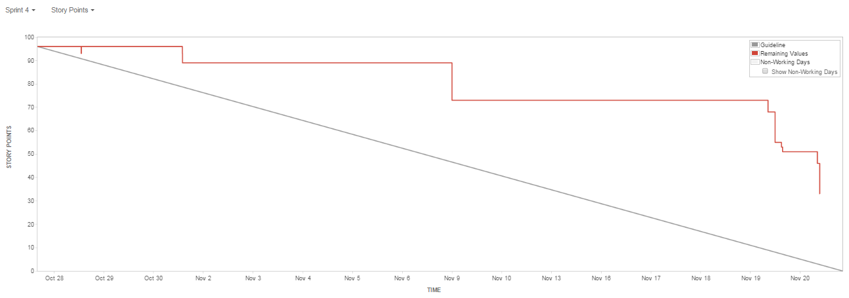
Sprint 4 – Metrics
Story points planned - 96 SP
Story points delivered 63 SP
Story points rolled over 33 SP (mostly pending testing)

Slide 8
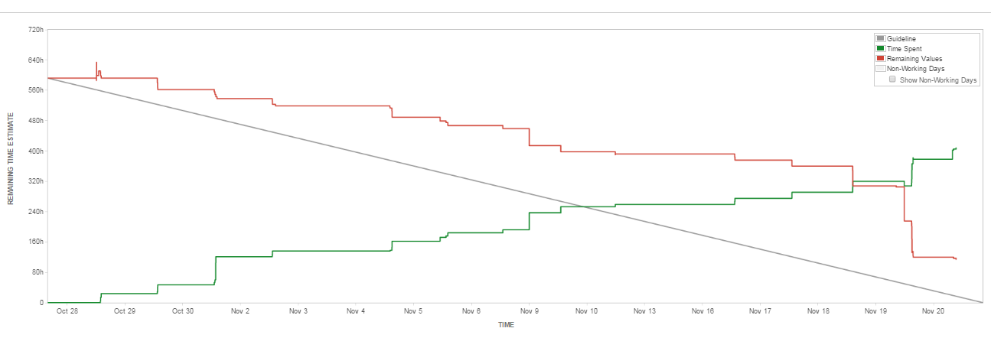
Sprint 4 – Metrics
Remaining effort left from Sprint 4 is 17 person days
In Story points it is equivalent to 21 SP rolled over to Sprint 5

Slide 9
Overall Project Status
Project Deliverables | Plan of Delivery | Revised Plan of Delivery | Remarks
User Accounts | Sprint 1 | Sprint 5 | Access management service created for admin. Authentication pending for FC.
Search Module | Sprint 2 | Sprint 5 | Re-factored Search module is tested. Search to include customer data , record titles
Edit the content: formulary status | Sprint 2 | Sprint 5
Edit the local content | Sprint 2 | Sprint 4 | Development complete, testing in progress.
Edit Notes | Sprint 2 | Sprint 4
Monitor content changes: approval /workflow | Sprint 4 | Sprint 4 | Roll over to Sprint 5

Slide 10
Overall Project Status contd.
Project Deliverables | Plan of Delivery | Revised Plan of Delivery | Remarks
Monitor content changes: audit | Sprint 4 | Sprint 6
Export formulary content | Sprint 4 | Sprint 6 | These reports are still under discussion
Admin Module | Sprint 4 | Sprint 5 | Web design is to be finalized
Drug Comparison | Sprint 5 |  | De-scoped (Comparison across drugs still in scope)
Annotation Search | Sprint 5 |  | De-scoped
View Changes across BNF versions | Sprint 5 | Sprint 4 | Reduced scope
Migration Activity | Sprint 3 onwards | Sprint 5 | Migration activity to initiate in sprint 5. Ian to visit on 26th November and we will try to complete migration for at least 1 Formulary

Slide 11
Sprint 5 Plan
Tasks | Details | Remarks
Table of contents | Main hierarchy (drugs, treatment summaries, medical devices) Borderline substances Wound management Interactions Guidance About Dental Practitioners Formulary Nurse Prescribers Formulary Cautionary and advisory labels for dispensed medicines Documents publication | The existing TOC to show additional details.
Rendering local content | Records Notes Formulary status, depending on breadcrumb | Appearing of customer data on FC.
Admin | Records Notes Formulary Status Manage Directories | Manage Directories is same as Documents in the existing version. Not required for BNF Hierarchy

Slide 12
Sprint 5 Plan
Tasks | Details | Remarks
Authentication | Single sign on read only authentication, similar to MC.
IE8 Integration | Ensuring IE8 compatibility
Search | Search by VTM or AMP id Search by record title (drugs, treatment summaries, preparations, interactions, borderline substances, wound management etc) Search for local records Search auto-complete for all relevant record types Design and build search results page | Add-on to existing Search functionality.
Complete pending development and testing for Sprint 4 Roll over work | Development pending for Managing Work Queue. All Pending Testing to be completed.
Migration Activity | Customer data to be migrated from PostgreSQL to Elastic Search | Migration activity to initiate in sprint 5. Ian to visit on 26th November and we will try to complete migration for at least 1 Formulary

Slide 13
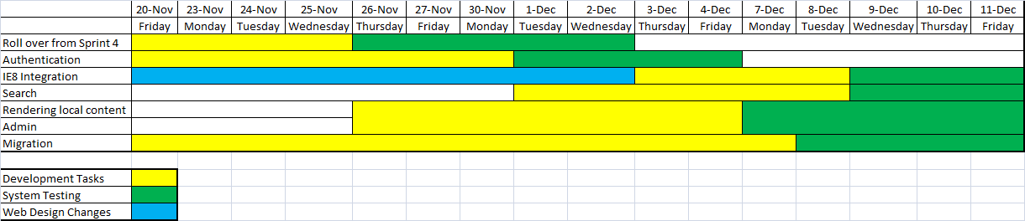
Sprint 5 Plan - A
All spare capacity will be used for developing stories from Sprint 6

Slide 14
Sprint 5 Plan – B (contingency)
Plan B does not include the development effort for IE8 integration
This plan will come into play if there is any deviation in planned deliverables for week ending 27th November .
All spare capacity will be used for developing stories from Sprint 6

Slide 15
Definition of Done
Definition of Done will be the System Test Cases as approved by RPS

Slide 16
Change Requests
Not Applicable

Slide 17
Risks & Impact
Turnaround time for clarifications – Clarifications if not answered at the earliest could impact on the deliverables/ cause rework.
Mitigation
Rave to proactively share list of clarifications with RPS periodically.
RPS to reply to clarifications with a one day turnaround time to minimize the impact on the deliverables and avoid rework.
Contingency
Rave to continue development making assumptions
Impact
Idle Time, Budget and Schedule

Slide 18
Risks & Impact contd.
Not following coding best practices – Code not following best practices, leads to Refactoring of code. This causes rework and impacts deliverables.
Mitigation
Peer review before checking-in code.
Ensuring the issues identified in earlier review are not repeated.
Contingency
Impact
Budget and Schedule

Slide 19
Risks & Impact contd.
Delay in finalizing web design – The delay in not getting a sign-off early into the sprint can impact deliverables..
Mitigation
Quick response from RPS on proposed changes by web design team
Multiple meetings if required to iron out open issues.
Discussion of design before working on a new module.
Contingency
Impact
Budget and Schedule

Slide 20
Questions?

